Slide 1
CREDES Summer School
Dependable Systems Design
June 2-3, 2011. Tallinn University of Technology, Estonia
Fault Modeling and Diagnosis in Digital Systems
Raimund Ubar

Slide 2
Outline
    Introduction: How much to test
    Two approaches for fault modeling
    Defects, errors, and fault models
    Fault properties: equivalence, redundancy, masking
    Conditional SAF and mapping defects from physical level to logic level
    High level fault modeling
    Overview of fault diagnosis methods
    Improvement of diagnostic resolution
    Conclusions

Slide 3
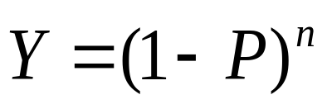
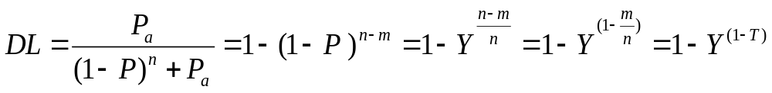
Introduction: Search for the Quality
Yield (Y)
P,n
Defect level (DL)
P_{a}
Quality policy
Design for testability
P - probability of a defect
n - number of defects
P_{a} - probability of accepting
a bad product
Testing
- probability of producing a good product

Slide 4
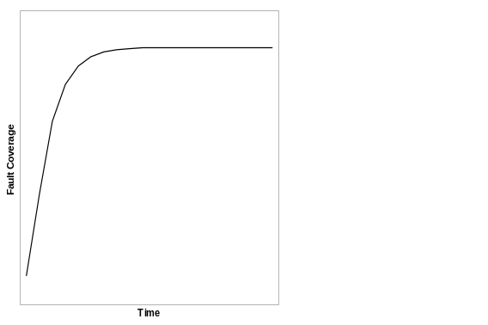
Introduction: The Problem is Money?
Test coverage function
Cost of quality
Cost
Cost of
testing
Time
Cost of
risc
Conclusion:
“The problem of testing
can only be contained
not solved”
T.Williams
Quality
0%
Optimum
test quality
100%

Slide 5






Achilleus, turtle and fault coverage
Patterns
Truth table for adder:
Patterns
Possible functions
1
00…000 00…001 00…010
…
11…111
01 0 1 0 1…101 00 1 1 1 0…011 00 1 0 0 1…101
…
00 0 0 0 0…111
2
Adder
0
50%
tested
...
2⁶⁴
00...010
64
Correct function
First pattern
Test quality:
100%
0%
93,75%
To win the turtle and to achieve 100% in test are both infeasible
4.
87,5%
3.
Start
First pattern
75%
Second pattern
Half way
50%

Slide 6
Fault Model Based Testing
Testing of structural faults:
1
2
Combinational circuit under test
n
Not yet tested faults
3. pat.
4. pat.
2. pat.
Fault coverage
100%
Faults covered by 1. pattern
Number of patterns
4

Slide 7
Comparison of Two Approaches for Testing
Testing of functions:
100%
Testing of faults:
0%
93,75%
Not tested faults
3. patttern
4. pat.
87,5%
2. pattern
4. pat.
Faulty functions covered by 1. pattern
Faults covered by 1. pattern
3. pattern
75%
Faulty functions covered by 2. pattern
100%
Testing of functions
100% will be reached when all faults from the fault list are covered
100% will be reached only after 2^{n} test patterns
50%
Testing of faults

Slide 8
Physical Defects as Fault Causes
    Physical defects may occur:
    Manufacturing process: missing contacts , parasitic transistors, gate oxide shorts, oxide break-down, metal-to silicon shorts, missing or wrong components, broken or shorted tracks (board design), etc.
    Process fabrication marginalities: line width variation, etc.
    Material and age defects: bulk defects (cracks, crystal imperfections), surface impurities, dielectric breakdown, electromigration, etc.
    Packaging: contact degradation, seal leaks, etc.
    Enviromental infuence: temperature related defects, high humidity, vibration, electrical stress, crosstalk, radiation, etc.

Slide 9
Soft and Hard Defects
    Defects can be divided roughly into two basic groups :
    Soft defects
      defects which cause speed fault
      show up at high speed or produce some temperature
      they need two or more test patterns for their activation and error observation (require carefully constructed transitions for defect activation);
      require tests to be applied at speed.
      examples: “high resistance” bridges, x-coupling, “tunneling break”
    Hard defects
      defects observated at all frequencies
      a test can be applied at slow speed
      they need only one-pattern test set
      example: “low resistance” bridge

Slide 10
Detecting of Defects
Defects, faults and errors
An instance of an incorrect operation of the system being tested is referred to as an error
The causes of the observed errors may be design errors or physical defects
Physical defects do not allow a direct mathematical treatment of testing and diagnosis
The solution is to deal with logical fault models
System
Defect
Component
Fault model
Error

Slide 11
Defect Manifestation and Test Methods
    Defects have to be measured and modeled into the faults
    They are manifested in different measurable manners:
    by changing a logical value on a circuit node (Boolean testing, or testing at the logical level)
    by increasing the steady state supply current (IDDQ testing)
    by changing time specifications (At-speed testing)
    by variation in one or a set of parameters such that their specific distribution in a circuit makes it fall out of specifications
    The test methods listed are not replacable
    They all have to be used for achieving high quality of testing

Slide 12
Why We Need Fault Models?
    Fault models are needed for
      test generation,
      test quality evaluation and
      fault diagnosis
    To handle real physical defects is too difficult
    The fault model should
      reflect accurately the behaviour of defects, and
      be computationably efficient
    Usually combination of different fault models is used
    Fault model free approaches (!)

Slide 13
Fault Modeling
    Fault modeling levels
      Transistor level faults
      Logic level faults
        stuck-at fault model
        bridging fault model
        open fault model
        delay fault model
      Register transfer level faults
      ISA level faults (MP faults)
      SW level faults
    Hierarchical fault handling
    Functional fault modeling
Low-Level models
High-Level models

Slide 14
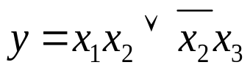
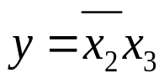
Structural and Functional Fault Modeling
x₁
a
Classification of fault models
x₂₁
&
x₂
Fault models are: explicit and implicit
  explicit faults may be enumerated
  implicit faults are given by some characterizing properties
Fault models are: structural and functional:
  structural faults are related to structural models, they modify interconnections between components
  functional faults are related to functional models, they modify functions of components
y
x₂₂
1
x₃
&
b
Structural faults:
- line a is broken
- short between x₂ and x₃
Functional fault:
Instead of

Slide 15
Structural Logic Level Fault Modeling
Why logic fault models?
complexity of simulation reduces (many physical faults may be modeled by the same logic fault)
one logic fault model is applicable to many technologies
logic fault tests may be used for physical faults whose effect is not completely understood
they give a possibility to move from the lower physical level to the higher logic level
Stuck-at fault model:
Two defects:
Broken line
Bridge to ground
x₁
x₁
x₂
1
x₂
1
Single model: Stuck-at-0
0V

Slide 16
Gate-Level Faults: SAF Model
    SAF is modeled by assigning a fixed (0,1) value to a signal line: stuck_at 0 (SAF0) or stuck_at 1 (SAF1)
    The death of the SAF model has been predicted, but several reasons and SAF properties have been persuaded that the SAF model continues in testing:
      simplicity: SAF is easy to apply to a CUT
      tractability: can be applied to millions of gates at once
      logic behavior: fault behavior can be determined logically, so simulation is straightforward and deterministic
      measurability: detection/non detection are easy
      adaptability: can apply on gates, systems, transistors, RTL, etc.
    SAF model is the industrial standard since 1959

Slide 17
Stuck-at Fault Properties
Fault equivalence and fault dominance:
A B C D Fault class
1 1 1 0 A/0, B/0, C/0, D/1 Equivalence class
0 1 1 1 A/1, D/0
1 0 1 1 B/1, D/0 Dominance classes
1 1 0 1 C/1, D/0
A
B
&
D
C
Fault collapsing:
1
≡ 1
1
≡ 0
1
&
1
&
&
&
≡ 1
≡ 0
≡ 0
≡ 1
Equivalence
Dominance
Dominance
Equivalence

Slide 18
Fault Redundancy
Hazard control circuitry:
Error control circuitry:
1
0→1
0→1
&
Decoder
1→0
1
1
&
1
≡ 1
&
⊕
1
E
≡ 0
Redundant AND-gate
Fault ≡ 0 is not testable
E ≡ 1 if decoder is fault-free
Fault ≡ 0 is not testable

Slide 19
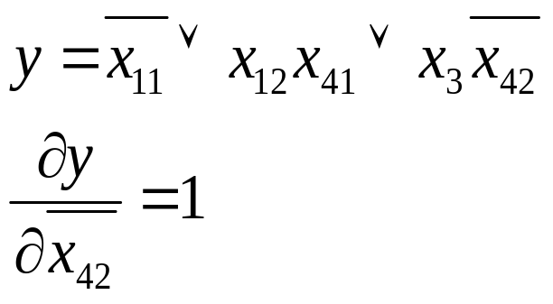
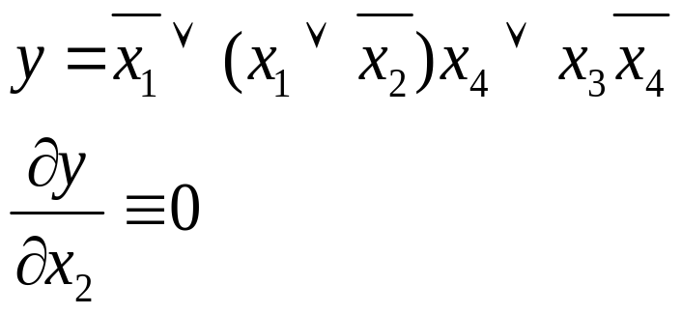
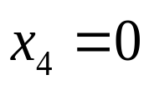
Fault Redundancy
Redundant gates (bad design):
x₁
x₁₁
&
x₁
x₁₂
&
1
y
1
x₄₁
&
x₂
&
1
y
&
x₃
x₄
&
x₃
x₄₂
&
x₄
&
&
if
Faults at x₂ are not testable, the node is redundant
Fault x₄₂ ≡ 0 is not testable

Slide 20
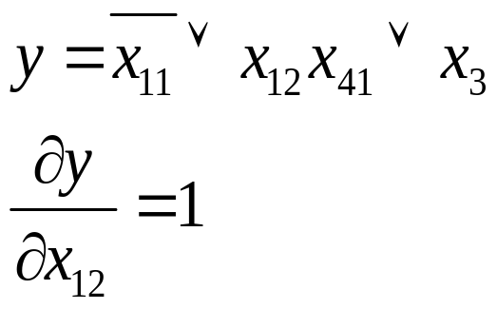
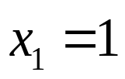
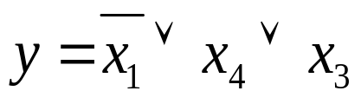
Fault Redundancy
Redundant gates (bad design):
x₁
x₁₁
x₁
x₁₁
&
&
x₁₂
x₁₂
1
y
&
1
y
x₄₁
&
x₄
x₃
x₃
x₄
&
x₄₂
&
if
Fault x₁₂ ≡ 1 is not testable
if
Final result of optimization:
x₁
x₄
1
y
Fault x₄₂ ≡ 0 is not testable
x₃

Slide 21
Delay Faults
Studies of the electrical properties of defects have shown that most of the random CMOS defects cause a timing (delay) effect rather than a other catastrophic defects (e.g. resistive bridges above a critical resistance cause delay)
Delay fault means that a good CUT may perform correctly its function in a system, but it fails in designed timing specifications
Delay faults could be caused by:
  subtle manufacturing process defects,
  transistor threshold voltage shifts,
  increased parasitic capacitance,
  improper timing design, etc.

Slide 22
Delay Fault Models
Delay faults are tested by test pattern pairs: - the first test pattern initializes the circuit, and
- the second pattern sensitizes the fault
x₁
B
11
00
&
001
D
x₂
A
01
&
y
10
&
C
x₃
&
110
11
Fault models:
Gate delay fault (delay fault is lumped at a single gate, quantitative model)
Transition fault (qualitative model, gross delay fault model, independent of the activated path)
Path delay fault (sum of the delays of gates along a given path)
Line delay fault (is propagated through the longest senzitizable path)
Segment delay fault (tradeoff between the transition and the path delay fault models)

Slide 23
Delay Fault Models
Robust teatable path delay faults:
Robust propagation
x₁
Robust path
x₂
&
(x1)
(x1)
&
y
x₁
x₁
x₂
&
&
1
x₂
x₃
11
00
Stable value needed
Non-robust propagation
Propagation criterion:
The faults wil be observed independent of the delays on signals outside the target path
x₁
00
x₂
&
(x1)
Value is not stable

Slide 24
Delay Fault Models
Non-robust testable path delay faults:
Non-robust propagation
Non-robust path
x₁
01 - Fault
(x1)
x₂
&
00 - OK
x₁
&
y
Early off-input Delay is detected
x₂
&
11
Bad luck: Fault masking
Propagation principles:
Robust path activation is not possible
Propagation criterion is less stringent
Detection of a fault depends on arrival times at the off-inputs
x₁
00
x₂
&
Late off-input Delay is masked

Slide 25
Comparison of Delay Faults
Fault models | Advantages | Limitations
Gate delay | All gates can be modeled | Distributed failures not considered Exact defect size not possible
Transition fault | Easy to model all gates | Distributed failures not considered
Path delay | Distributed failures considered | Impossible to enumerate all paths
Line delay | All gates are modeled Distributed failures Better coverage metric Additional fault coverage by using multi-path technique | Existence of nonrobust test May fail for some shorter paths
Segment delay | General delay defect from spot to distributed failures | Longest delay path may not be tested
Copyright © A.K.Majhi, V.D.Agrawal 1997

Slide 26
Multiple Fault Problem
Multiple stuck-fault (MSF) model is a straightforward extension of the single stuck-fault (SSF) model where several lines can be simultaneously stuck
If n - is the number of possible SSF sites, there are 2n possible SSFs, but there are 3^{n} -1 possible MSFs
If we assume that the multiplicity of faults is no greater than k , then the number of possible MSFs is
Σ^{k}_{i=1} {C^{n}_{i}}2^{i}
{C^{n}_{i}} – number of sets of lines, 2^{i} - number of faults of the set
The number of multiple faults is very big. However, their consideration is needed because of possible fault masking

Slide 27
Multiple Fault Testing
Multiple fault F may be not detected by a complete test T for single faults
because of circular masking among the faults in F
Example:
Test T={1111, 0111, 1110, 1001, 1010, 0101} detects every SAF
The only test in T that detects b ≡ 1 and c ≡ 1 is 1001
However, the multiple fault
{b≡1, c≡1} is not detected because under the test 1001,
b ≡ 1 masks c ≡ 1, and
c ≡ 1 masks b ≡ 1
a
1
1/0
0/1
&
b
1
&
Two faults
0/1
0
&
0/1
&
0/1
1
c
&
d
1
1/0

Slide 28
Multiple Fault Testing
Testing multiple faults by pairs of patterns
Tested path
a
11
10
(00)
To test a path under condition of multiple faults, two pattern test is needed
Either the faults on the path under test are detected, or the masking fault is detected
Example:
The lower path from b to output is under test
A pair of patterns is applied on b
There is a masking fault c ≡ 1
1. pattern: fault b is masked
2. pattern: fault c is detected
&
b
01
(11)
11
(11)
&
≡1 faults
01 (00)
&
01
(11)
00
&
(11)
c
10 (11)
11
&
d
11(00)
The possible results:
  01 - No faults detected
  00 - Either b ≡ 0 or c ≡ 1 detected
  11 - The fault b ≡ 1 is detected

Slide 29
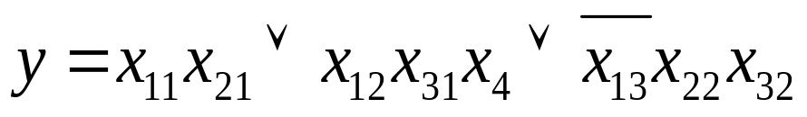
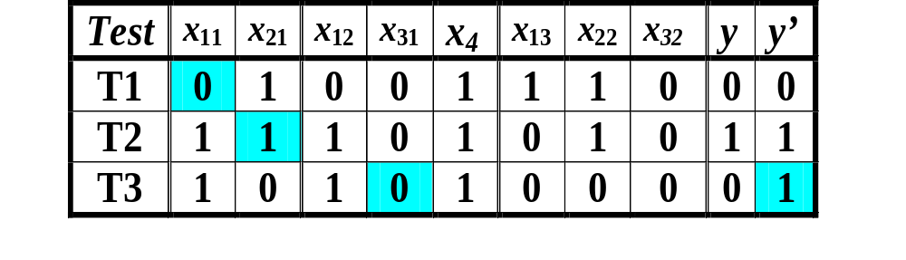
Test Generation for Multiple Faults
Testing multiple faults by groups of patterns
Multiple fault: x₁₁≡1, x₂₁≡0, x₃₁≡1
x₁
x₂
&
Fault masking
Fault detecting
T1
T2
T3
x₃
&
1
y
x₄
x₁₁≡1
x₂₁≡0
x₃₁≡1
&
&

Slide 30
Test Generation for Multiple Faults
Method of test groups on DDs
Test group for testing a part of the circuit
x₁
x₁ x₂ x₃ x₄ y
₁ ₁ ₀ ₁ ₁
₀ ₁ ₀ ₁ ₀
₁ ₀ ₀ ₁ ₀
₋
x₂
&
x₃
y
x₄
&
1
These signals must be stable
&
&
Fault masking
Fault detecting
T1
T2
T3
x₁₁≡1
x₂₁≡0
x₃₁≡1

Slide 31
Hierarchical Test Generation
Component under test
Component
level test:
D₁ | D₂ | D
0 | 0 | 0
0 | 1 | 1
1 | 0 | 1
D₂
x₁
0
x₂
0
&
&
1
y
x₃
D₁
&
D₁
D
x₄
1
x₅
1
&
1
D
Network level test:
&
D₂
&
x₁ | x₂ | x₃ | x₄ | x₅ | y
D₂ | 0 | D₁ | 1 | 1 | D
1
This is a robust test regarding multiple faults
Symbolic test: contains 3 patterns

Slide 32
Transistor Level Faults
Logic level interpretations:
Stuck-at-1
Broken (change of the function)
Bridging
Stuck-open
(change of the number of states)
Stuck-on (change of the function)
Short (change of the function)
Stuck-off (change of the function)
Stuck-at-0

Slide 33
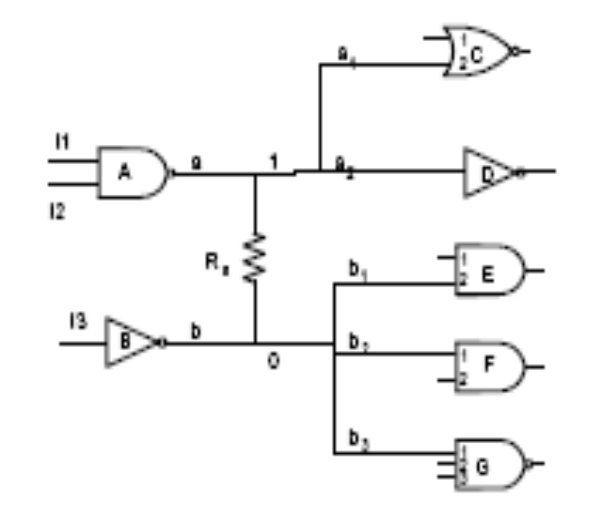
General Fault Model Classes
Extensions of the SAF model for two large general fault classes of modeling physical defects:
Multiple fault
Resistive bridge fault
0
1
0
1
Defect
SAF
Conditional fault
Pattern fault
Constrained SAF
Single faulty signal
X-fault
Byzantine fault
Bridges
Stuck-opens
Multiple faulty signal

Slide 34
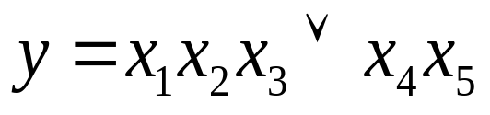
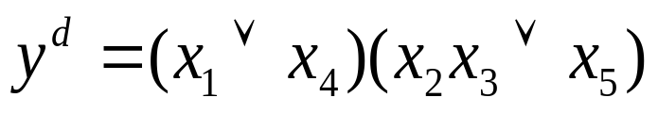
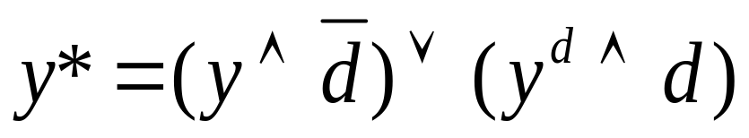
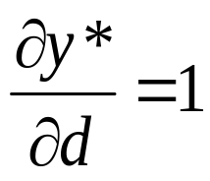
Mapping Transistor Faults to Logic Level
A transistor fault causes a change in a logic function not representable by SAF model
Function:
y
Faulty function:
x₁
x₄
Short
0 – defect d is missing
1 – defect d is present
Defect variable:
d =
x₂
Generic function with defect:
x₃
x₅
Mapping the physical defect onto the logic level by solving the equation:

Slide 35
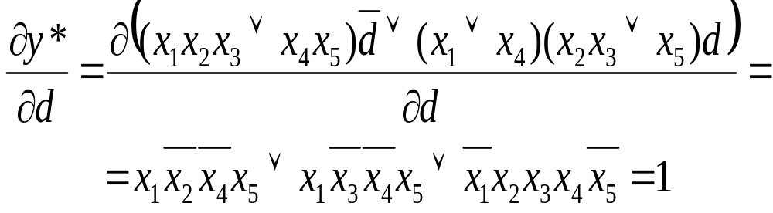
Mapping Transistor Faults to Logic Level
Function:
Faulty function:
Generic function with defect:
y
x₁
x₄
Short
Test calculation by Boolean derivative:
x₂
x₃
x₅

Slide 36
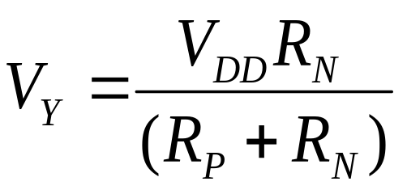
Transistor Level Stuck-On Faults
NOR gate
x₁ | x₂ | y | y^{d}
0 | 0 | 1 | 1
0 | 1 | 0 | 0
1 | 0 | 0 | V_{Y}/I_{DDQ}
1 | 1 | 0 | 0
Stuck-on
V_{DD}
V_{DD}
x₁
x₁
x₂
x₂
R_{N}
Y
Y
x₁
x₂
x₁
x₂
V_{SS}
R_{P}
V_{SS}
Conducting path for “10”

Slide 37
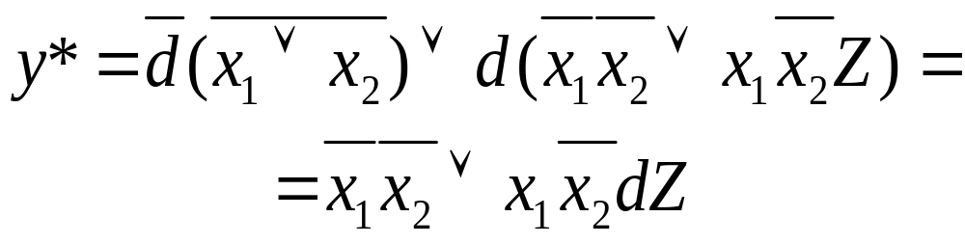
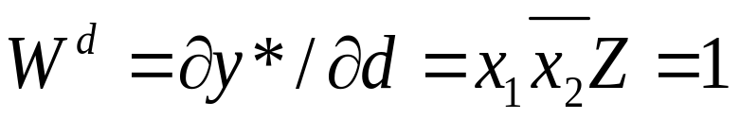
Conditional SAF Model for Stuck-ON
NOR gate
x₁ | x₂ | y | y^{d}
0 | 0 | 1 | 1
0 | 1 | 0 | 0
1 | 0 | 0 | Z: V_{Y}/I_{DDQ}
1 | 1 | 0 | 0
Stuck-on
V_{DD}
x₁
x₂
R_{N}
Y
x₁
x₂
R_{P}
V_{SS}
Condition of the fault potential detecting:
Conducting path for “10”

Slide 38
Transistor Level Stuck-open Faults
NOR gate
x₁ | x₂ | y | y^{d}
0 | 0 | 1 | 1
0 | 1 | 0 | 0
1 | 0 | 0 | Y’
1 | 1 | 0 | 0
V_{DD}
Stuck-open
V_{DD}
x₁
x₁
x₂
x₂
Y
Y
x₁
x₂
x₁
x₂
Test sequence is needed: 00,10
V_{SS}
V_{SS}
No conducting path from V_{DD} to V_{SS} for “10”

Slide 39
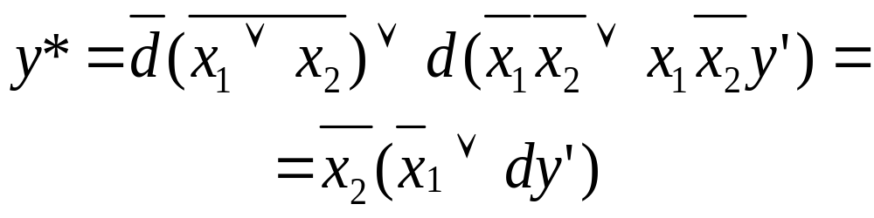
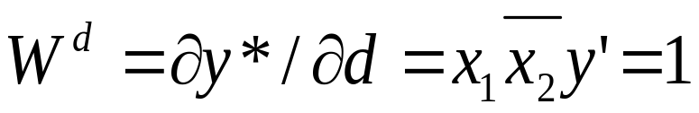
Conditional SAF for Stuck-Open
NOR gate
x₁ | x₂ | y | y^{d}
0 | 0 | 1 | 1
0 | 1 | 0 | 0
1 | 0 | 0 | Y’
1 | 1 | 0 | 0
Test sequence is needed: 00,10
Stuck-open
t x₁ x₂ y
1 0 0 1
2 1 0 1
V_{DD}
x₁
x₂
Y
x₁
x₂
V_{SS}
No conducting path
from V_{DD} to V_{SS} for “10”

Slide 40
Bridging Faults
Bridging faults model all defects that cause unintended electrical connections across two or more circuit nodes
Physical causes of the shorts:
  extra conducting material: e.g. photolitographic printing error, conductive particle contamination, etc.
  missing insulating material: printing error, gate-oxide defect causing pinhole, insulating particle contamination, etc.
Bridges have non-linear or linear properties with resistance from zero to > 1 MΩ. The typical values for resistance:
  logical critical resistance is 100 Ω to 2 kΩ
  timing critical resistance is 5 kΩ to 10 kΩ
Bridging faults can be classified:
  inter-gate shorts (sequential behavior if short creates feedback)
  intra-gate shorts

Slide 41
Bridging Fault Models
x₁
x’₁
Wired AND/OR model
x₂
x’₂
W-AND:
Fault-free |  | W-AND |  | W-OR
x₁ | x₂ | x’₁ | x’₂ | x’₁ | x’₂
0 | 0 | 0 | 0 | 0 | 0
0 | 1 | 0 | 0 | 1 | 1
1 | 0 | 0 | 0 | 1 | 1
1 | 1 | 1 | 1 | 1 | 1
x₁
x’₁
&
x₂
x’₂
W-OR:
x₁
x’₁
1
x₂
x’₂

Slide 42
Bridging Fault Models
Dominant bridging model
x₁
x’₁
x₂
x’₂
x₁ dom x₂:
Fault-free |  | x₁ dom x₂ |  | x₂ dom x₁
x₁ | x₂ | x’₁ | x’₂ | x’₁ | x’₂
0 | 0 | 0 | 0 | 0 | 0
0 | 1 | 0 | 0 | 1 | 1
1 | 0 | 1 | 1 | 0 | 0
1 | 1 | 1 | 1 | 1 | 1
x₁
x’₁
x₂
x’₂
x₂ dom x₁:
x₁
x’₁
x₂
x’₂

Slide 43
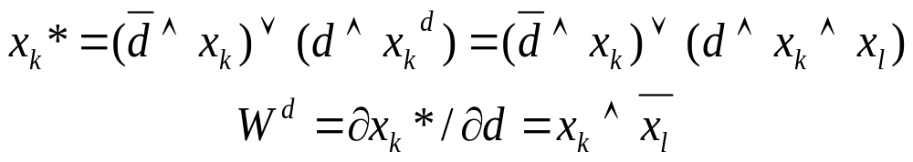
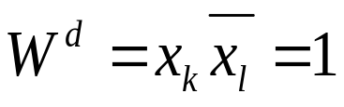
Conditional SAF Model for Bridging
x_{k}
x*_{k}
Example:
Bridging fault between leads x_{k} and x_{l}
The condition means that
    in order to detect the short between leads x_{k} and x_{l}
    on the lead x_{k}
    we have to assign to x_{k} the value 1 and to x_{l} the value 0.
d
x_{l}
x_{k}*= f(x_{k},x_{l},d)
Wired-AND model

Slide 44
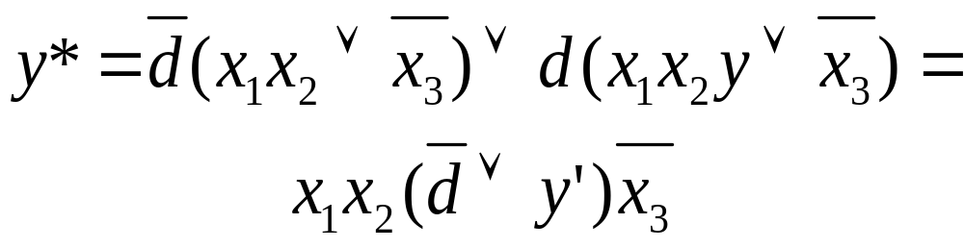
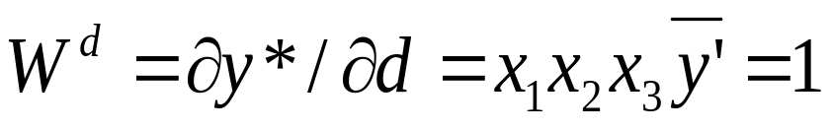
Conditional SAF for Sequential Bridge
Example:
Bridging fault causes a feedback loop:
A short between leads x_{k} and x_{l} changes the combinational circuit into sequential one
x₁
&
y
x₂
&
x₃
Equivalent faulty circuit:
x₁
&
y
&
x₂
x₃
Sequential constraints:
t x₁ x₂ x₃ y
1 0 1 0
2 1 1 1 1
&

Slide 45
Simulating of Bridging Faults
In absence of any physical layout information, a fault list may be created by exhaustively enumerating every two nets in the design
This method, however, is only feasible for very small circuits, because the number of all net pairs in the design grows exponentially
For larger circuits, fault sampling may be used, where a set of net pairs is chosen randomly
An alternative method of creating a bridging fault list without layout information is to enumerate all possible input-to-input and input-to-output shorts for each gate (or cell) in the design
This method would require physical layout information

Slide 46
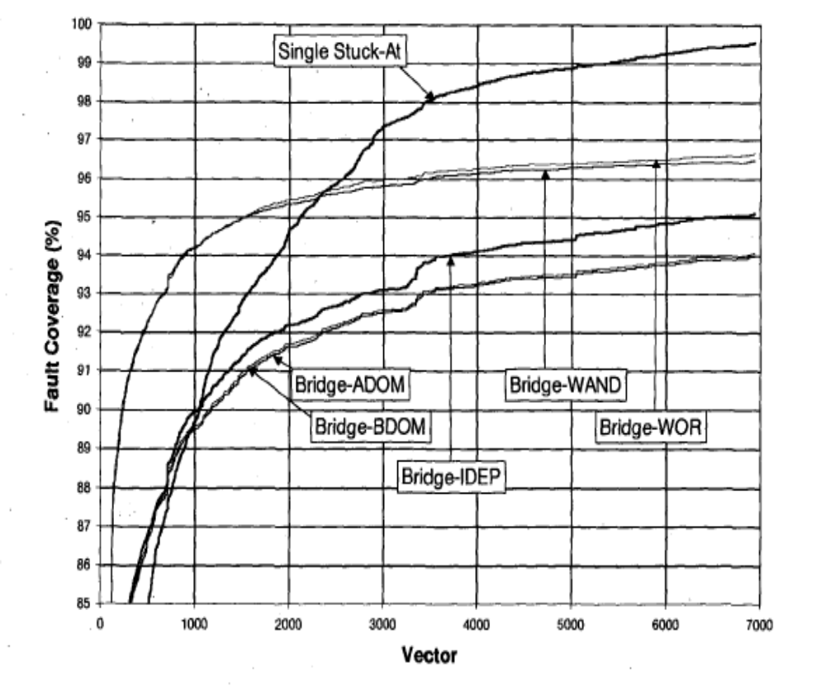
SAF vs. Bridging Fault Models
Comparison of stuck-at fault test coverage with coverages for different bridging fault models:
Wired AND
Wired OR
A-Dominated
B-Dominated
Implem. dependent
Copyright © S.Ma, I.Shaik, R.Scott Fetherson, 1999

Slide 47
Advanced Bridging Fault Models
Constrained Multiple Line SAF Model
Bridge between a and b
The two branches of a and three branches of b could be interpreted by the driven gates to be any one of the 32 combinations
One corresponds to fault free situation, 31 correspond to faulty situations
Method of implicit fault simulation: assign one branch with faulty value, and let other branches with unknown values
Copyright © G.Chen, S.Reddy, I.Pomeranz, J.Rajski, P.Engelke, B.Becker 2005

Slide 48
Advanced Bridging Fault Models
Constrained (conditional) Multiple Line SAF Model
Advantages:
Method is uniform to consider opens and bridges
Method does not need circuit level information such as relative strengths and threshold voltages of transistors associated with bridge
Method allows different levels of model complexity and accuracy (e.g. using implicit simulation with different number of unknown values)
Method is based on constrained SAF model, hence, traditional gate level tools can be used

Slide 49
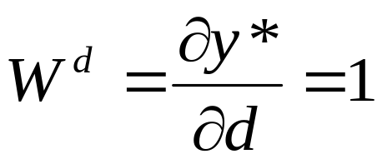
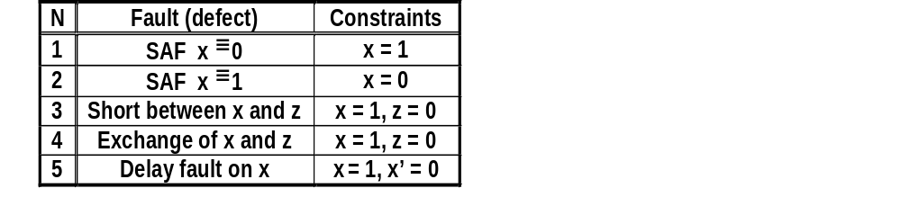
Conditional SAF Model Examples
Constraints:
Component with defect:
Component F(x₁,x₂,…,x_{n})
y
W^{d}
Constraints examples:
Defect
Logical constraints
Conditional SAF:
(dy,W^{d}), (dy,{W_{k}^{d}})

Slide 50
Hierarchical Diagnostic Modeling
RT Level
Logic level
Transistor level
Uniform fault model
R
&
&
1
M
1
+
&
M
R
&
3
2
1
IN
M
2
*
&
&
Defect mapping
x₁
x₄
x₂
System level
Defect
x₃
x₅
dy
W^{d}
Component
y*
Error
Logic level
Hierarchical fault propagation

Slide 51
Philosophy of the Uniform Fault Model
Functions
Structure
Higher level
System
W^{F}_{k}
Module
k
System:
F
Test
W
S
Lower level
k
W^{S}_{k}
Fault model
Bridge
W
F
Network of modules
k
Network of modules
Module
F
k
Test
W
S
ki
W^{F}_{k} interpretation:
Test – at the lower level
Fault model – at the higher level
Interface between levels
W
F
Network of components
ki
Component
F
ki
Test
W
d
ki
Network of transistors

Slide 52
Fault Model vs. Test
Component under test
Component
level test
D₁ | D₂ | D
0 | 0 | 0
0 | 1 | 1
1 | 0 | 1
D₂
x₁
0
x₂
0
&
&
1
y
x₃
D₁
&
D₁
D
x₄
1
x₅
1
&
1
D
Network level
fault model for a component
(constrained SAFs)
&
D₂
&
1
x₁ | x₂ | x₃ | x₄ | x₅ | y
D₂ | 0 | D₁ | 1 | 1 | D
Symbolic pattern

Slide 53
Motivations for High-Level Fault Models
    Current situation:
    The efficiency of test generation (quality, speed) is highly depending on
      the description method (level, language), and
      fault models
    Because of the growing complexity of systems, gate level methods have become obsolete
    High-Level methods for diagnostic modeling are today emerging, however they are not still mature
    Main disadvantages:
    The known methods for fault modeling are
      dedicated to special classes (i.e. for microprocessors, for RTL, VHDL etc. languages...), not general
      not well defined and formalized

Slide 54
Fault Models for High-Level Components
Decoder:
    - instead of correct line, incorrect is activated
    - in addition to correct line, additional line is activated
    - no lines are activated
Multiplexer (n inputs log₂ n control lines):
    - stuck-at - 0 (1) on inputs
    - another input (instead of, additional)
    - value, followed by its complement
    - value, followed by its complement on a line whose address differs in 1 bit
Memory fault models:
    - one or more cells stuck-at - 0 (1)
    - two or more cells coupled

Slide 55
Fault models and Tests
Dedicated functional fault model for multiplexer:
  stuck-at-0 (1) on inputs,
  another input (instead of, additional)
  value, followed by its complement
  value, followed by its complement on a line whose address differs in one bit
Functional fault model
Test description

Slide 56
Register Level Fault Models
RTL statement
K: (If T,C) R_{D} ← F(R_{S1}, R_{S2}, … R_{Sm}), → N
Components (variables)
of the statement:
RT level faults:
K - label
T - timing condition
C - logical condition
R_{D} - destination register
R_{S} - source register
F - operation
← - data transfer
N - jump to the next
statement
K → K’ - label faults
T → T’ - timing faults
C → C’ - logical condition faults
R_{D} → R_{D} - register decoding faults
R_{S} → R_{S} - data storage faults
F → F’ - operation decoding faults
← - data transfer faults
→ N - control faults
(F) → (F)’ - data manipulation faults

Slide 57
Microprocessor Fault Model
Faults affecting the operation of microprocessor can be divided into the following classes:
    addressing faults affecting register decoding
    addressing faults affecting the instruction decoding and – sequencing functions;
    faults in the data-storage function;
    faults in the data-transfer function;
    faults in the data-manipulation function

Slide 58
Microprocessor Fault Model
Addressing faults which affect register decoding:
For multiplexers under a fault, for a given source address any of the following may happen: addressing faults affecting the instruction decoding and – sequencing functions;
  F1 - no source is selected
  F2 - wrong source is selected
  F3 - more than one source is selected
For demultiplexers under a fault, for a given destination address:
  F4 - no destination selected
  F5 - instead of, or in addition to the selected correct destination, one or more other destinations are selected

Slide 59
Microprocessor Fault Model
Addressing faults which affect microinstruction execution::
  F6 - microorder not activated
  F7 - microorder is erroneously activated – D1
  F8 - a different set of microinstructions is activated instead of, or in addition to
Data storage faults:
F9: one or more cells stuck at 0 or 1;
F10: one or more cells fail to make a 0→1 or 1 → 0 transitions;
F11: two or more pairs of cells coupled;
Bus faults:
F12: one or more lines stuck at 0 or 1;
F13: one or more shorted
Data manipulation faults:
F14: exhaustive or pseudoexhaustive testing approach

Slide 60
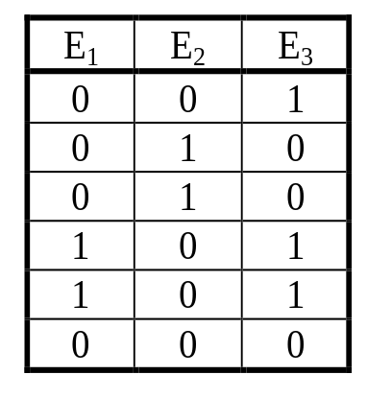
Test Related Tasks and Tools
Fault table
Test experiment data
Fault
modeling
F
1
F
2
F
3
F
4
F
5
F
6
F
7
T
1
0
1
1
0
0
0
0
T
2
1
0
0
1
0
0
0
T
3
1
1
0
1
0
1
0
How many rows
and columns should be
in the Fault Table?
T
4
0
1
0
0
1
0
0
T
5
0
0
1
0
1
1
0
T
6
0
0
1
0
0
1
1
Fault
F
5
located
Testing
Fault diagnosis
Fault simulation
Test generation

Slide 61
Fault Simulation
    Problems:
      How to represent the system?
      How to model the faults?
    Methods:
      Simulation of faults
      Fault reasoning
      Parallel processing
Goal: generate diagnostic information
Faults
Responses
Stimuli
Test
Digital
system
Fault dictionary
Test analysis: fault simulation

Slide 62
Fault Diagnosis
    Combinational approach (cause-effect)
    Sequentional approach (effect-cause)
        Output response related
        Rasoning of internal signals
Cause-effect
Fault
Diagnosis
Test
Stimuli
Digital system
Responses
Fault dictionary
Effect-cause

Slide 63
Fault diagnosis
Fault Diagnosis methods
Combinational methods
  The process of fault localization is carried out after finishing the whole testing experiment by combining all the gathered experimental data
  The diagnosis is made by using fault tables or fault dictionaries
Sequential methods (adaptive testing)
  The process of fault location is carried out step by step, where each step depends on the result of the diagnostic experiment at the previous step
Sequential fault diagnosis can be carried out either
  by observing only output responses of the UUT or
  by pinpointing by a special probe also internal control points of the UUT (guided probing)

Slide 64
Combinational Fault diagnosis
Fault localization by fault table
Test responses:
F
1
F
2
F
3
F
4
F
5
F
6
F
7
T
1
0
1
1
0
0
0
0
T
2
1
0
0
1
0
0
0
T
3
1
1
0
1
0
1
0
T
4
0
1
0
0
1
0
0
T
5
0
0
1
0
1
1
0
T
6
0
0
1
0
0
1
1
Fault
F
5
located
Faults
F
and
F
are not distinguishable
1
4
No match, diagnosis not possible

Slide 65
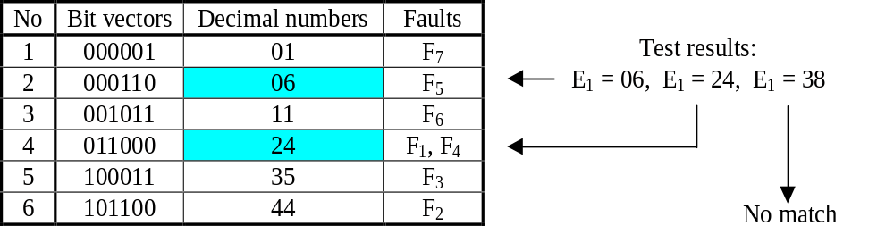
Combinational Fault Diagnosis
Fault localization by fault dictionaries
Fault dictionaries contain the sama data as the fault tables with the difference that the data is reorganised
The column bit vectors can be represented by ordered decimal codes or by some kind of compressed signature

Slide 66
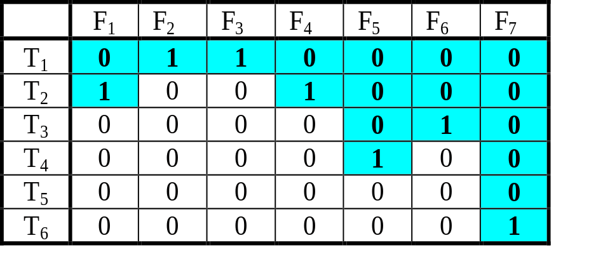
Combinational Fault Diagnosis
Minimization of diagnostic data
To reduce the cost of building a fault table, the detected faults may be dropped from simulation
All the faults detected for the first time by the same vector produce the same column vector in the table, and will included in the same equivalence class of faults
Testing can stop after the first failing test, no information from the following tests can be used
With fault dropping, only 19 faults need to be simulated compared to the all 42 faults
The following faults remain not distinguishable:
{F₂, F₃}, {F₁, F₄}.
A tradeoff between computing time and diagnostic resolution can be achieved by dropping faults after k >1 detections

Slide 67
Improving Diagnostic Resolution
Generating tests to distinguish faults
To improve the fault resolution of a given test set T, it is necessary to generate tests to distinguish among faults equivalent under T
Consider the problem of distinguishing between faults F1 and F2. A test is to be found which detects one of these faults but not the other
The following cases are possible:
  F1 and F2 do not influence the same outputs
    A test should be generated for F1 (F2) using only the circuit feeding the outputs influenced by F1 (F2)
  F1 and F2 influence the same set of outputs.
    A test should be generated for F1 (F2) without activating F2 (F1)
How to activate a fault without activating another one?

Slide 68
Improving Diagnostic Resolution
Generating tests to distinguish faults
Faults are influencing on different
outputs:
Method:
F1 may influence both outputs, F2 may influence only x₈
A test pattern 0010 activates F1 up to the both outputs, and F2 only to x₈
If both outputs will be wrong, F1 is present
If only x₈ will be wrong, F2 is present
F1: x_{3,1} ≡ 0
x
0
1
1
x
x
0
7
2
1
x
x
5
x
1
3,1
x
3
x
1
8
3,2
x
6
x
&
4
0
F2: x₄ ≡ 1

Slide 69
Improving Diagnostic Resolution
Generating tests to distinguish faults
How to activate a fault
without activating another one?
Method:
Both faults influence the same output of the circuit
One of them should be blocked
Two possibilities:
A test pattern 0100 activates the fault F2. F1 is not activated: the line x_{3,2} has the same value as it would have if F1 were present
A test pattern 0110 activates the fault F2. F1 is now activated at his site but not propagated through the AND gate
x
0
1
1
x
x
1
x
x
7
2
1
5
5,1
x
5,2
0/1
x
3,1
x
3
x
1
x
8
3,2
x
6
x
&
4
0
F1: x_{3,2} ≡ 0 F2: x_{5,2} ≡ 1

Slide 70
Improving Diagnostic Resolution
Generating tests to distinguish faults
How to activate a fault
without activating another one?
Method:
Both of the faults may influence only the same output
Both of the faults are activated to the same OR gate, none of them is blocked
However, the faults produce different values at the inputs of the gate, they are distinguished
If x₈ = 0, F1 is present
Otherwise,
  either F2 is present
  or none of the faults F1 and F2 are present
F1: x_{3,1} ≡ 1
x
1
1
1
x
x
0
x
x
7
2
5
5,1
1
x
0
x
5,2
x
3
x
3,1
1
x
8
3,2
x
6
x
&
4
1
F2: x_{3,2} ≡ 1

Slide 71
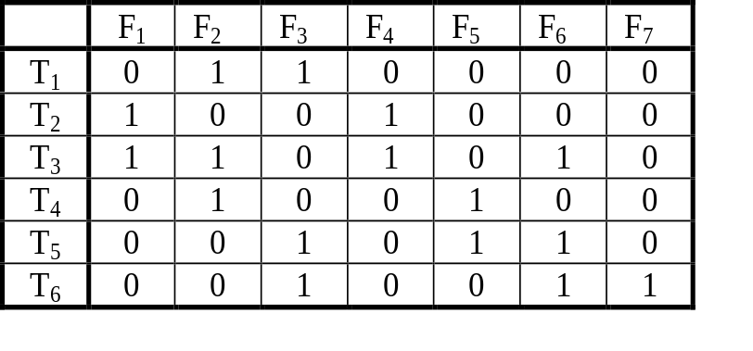
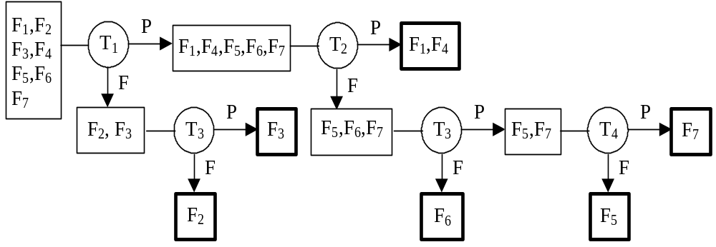
Sequential Fault Diagnosis
Sequential fault diagnosis by Edge-Pin Testing
Two faults F₁,F₄ remain indistinguishable
Not all test patterns used in the fault table are needed
Different faults need for identifying test sequences with different lengths
The shortest test contains two patterns,
the longest four patterns
Diagnostic tree:

Slide 72
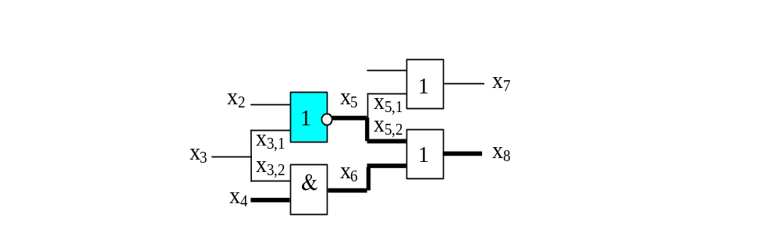
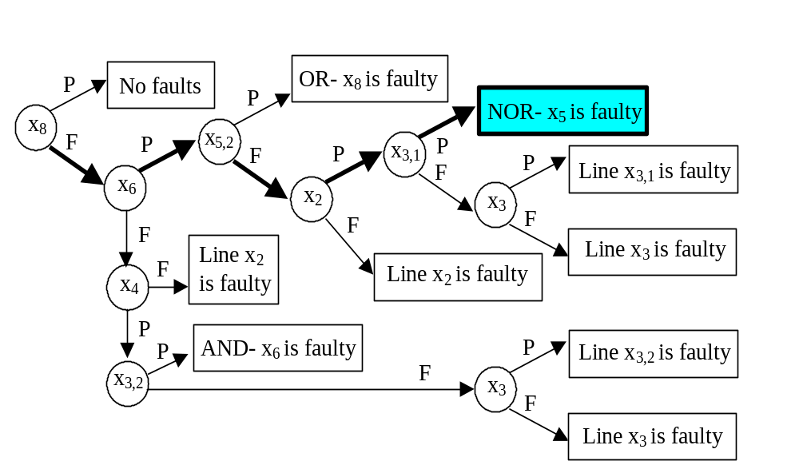
Sequential Fault Diagnosis
Guided-probe testing at the gate level
Faulty circuit:
Searh tree:

Slide 73
Diagnosis of Fault Model Free Defects
Conditional SAF model:
Real test experiment
Simulation
Circuit Under Diagnosis
Faulty machine
FM(f)
Fault evidence:
for test pattern t
e(f,t) = (Δτ_{t} , Δσ_{t}, Δl_{t}, Δγ_{t})
Δγ_{t} = min (Δσ_{t}, Δl_{t})
for full test T (sum)
e(f,T) = (Δτ , Δσ, Δl, Δγ)
Δτ_{t}
Δσ_{t}
f
Δl_{t}
Fault
Test pattern t
Copyright: H.J.Wunderlich 2007

Slide 74
Diagnosis of Fault Model Free Defects
Real test experiment
Conditional SAF:
either
Δσ_{t} = 0 (condition is not satisfied)
or
Δl_{t} = 0
Hence Δγ_{t} = min (Δσ_{t}, Δl_{t}) = 0
If Δγ_{t} >0,
the conditional fault is not a candidate
Simulation
Circuit Under Diagnosis
Faulty machine
FM(f)
Δτ_{t}
Δσ_{t}
f
Δl_{t}
Fault
Test pattern t
Copyright: H.J.Wunderlich 2007

Slide 75
Diagnosis of Fault Model Free Defects
Real test experiment
Different classical fault cases:
Simulation
Circuit Under Diagnosis
Faulty machine
FM(f)
Classic model | l_{t} | τ_{t} | γ_{t}
Single SAF | 0 | 0 | 0
Multiple SAF | 0 | >0 | 0
Single conditional SAF | >0 | 0 | 0
Multiple cond. SAF | >0 | >0 | 0
Delay fault | >0 | 0 | >0
General case | >0 | >0 | >0
Δτ_{t}
Δσ_{t}
f
Δl_{t}
Fault
Test pattern t
Copyright: H.J.Wunderlich 2007

Slide 76
Diagnosis of Fault Model Free Defects
Real test experiment
Simulation
For each fault f with
e(f,T) = (Δτ , Δσ, Δl, Δγ)
we have
Δσ + Δl) > 0
if T detects f .
Othervise f may be undetected (because of redundancy)
For further analysis the evidences will be ranked
Circuit Under Diagnosis
Faulty machine
FM(f)
Δτ_{t}
Δσ_{t}
f
Δl_{t}
Fault
Test pattern t
Copyright: H.J.Wunderlich 2007

Slide 77
Diagnosis of Fault Model Free Defects
Real test experiment
Simulation
Ranking (on the top the most suspicious faults):
By increasing γ_{T}
(single SAF on top)
(2) If γ_{T} are equal then
by decreasing σ_{T}
(3) If γ_{T} and σ_{T} are
equal then by
increasing l_{T}
Δγ_{t} = min (Δσ_{t}, Δl_{t})
Example:
Circuit Under Diagnosis
Faulty machine
FM(f)
SAF | γ_{T} | σ_{T} | l_{T}
f₁ | 0 | 42 | 0
f₂ | 30 | 42 | 15
f₃ | 30 | 42 | 25
f₄ | 30 | 42 | 30
f₅ | 30 | 36 | 38
f₆ | 38 | 23 | 22
f₇ | 38 | 23 | 23
Δτ_{t}
Δσ_{t}
f
Δl_{t}
Fault
Test pattern t
Copyright: H.J.Wunderlich 2007

Slide 78
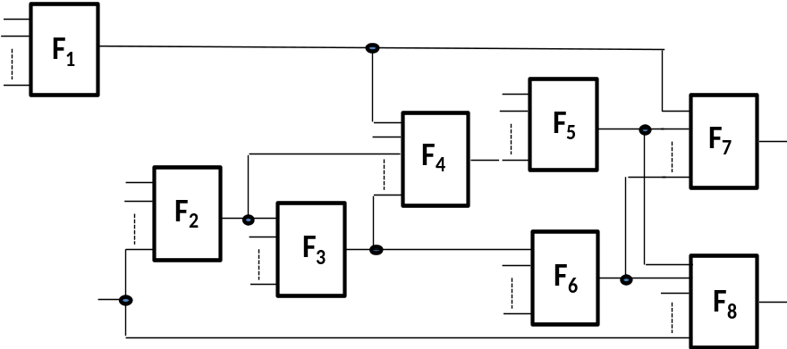
Diagnosis of Defective Macros
Network of macros:
Failed
Passed
Test results::
Test # | Macros
 | 1 | 2 | 3 | 4 | 5 | 6 | 7 | 8
1 | 1 |  | 1 |  |  | 1 | 1 | 1
2 |  |  |  |  |  |  | 1 | 1
3 |  |  | 1 |  |  | 1 | 1 | 1
4 |  | 1 | 1 |  |  | 1 | 1 | 1
5 |  |  |  | 1 | 1 |  | 1 | 1
Conditions
Conditions
Suspected defective macros
F₃
Observed SAF
F₆
Observed SAF
T1: 01101
Failed
T1: 01101
Failed
T3: 11000
T4: 01011
Passed
Passed
T3: 11000
T4: 01101
Passed
Passed

Slide 79
Conclusions
There is a huge number of fault models in use
Low level SAF model is still de facto standard for test quality measuring by fault simulation
Conditional SAF is a promising model for covering a large class of physical defects
Fault model free diagnosis is a new promising approach for locating physical defects
High-level fault models are good guides for high-level test generation
There is no difference between fault and test, it is only an interpretation issue www.pld.ttu.ee/~raiub/

Slide 80
For Additional Reading
L.-T.Wang, C.-W.Wu, X.Wen. VLSI Test Principles and Architectures. Elsevier, 2006.
D.Gizopulos. Advances in Electronic Testing, Technology & Engineering. Springer, 2006.
O.Novak, E.Gramatova, R.Ubar. Handbook of Testing Electronic Systems. Czech TU Publishing House, 2005.
N.Jha, S.Gupta. Testing of Digital Systems. Cambridge Univ. Press, 2003.
M.L.Bushnell, V.D.Agrawal. Essentials of Electronic Testing. Kluwer Academic Publishers, 2000.
M.Sachdev. Defect Oriented Testing for CMOS Analog and Digital Circuits. Kluwer Academic Publishers, 1998.
A.Kristic, K.-T.Cheng. Delay Fault Testing for VLSI Circuits. Kluwer Academic Publishers, 1998.

